Slide 1
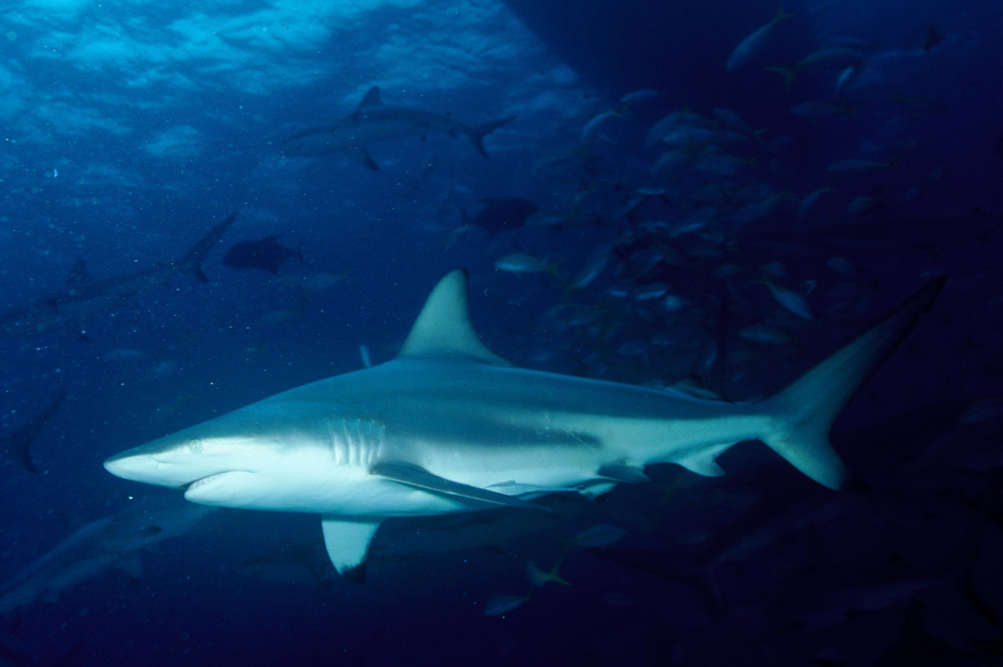
Flappy Shark
Designed by Orlin Ivanov
This Photo by Unknown author is licensed under CC BY.

Slide 2
What is Flappy Shark ?

Slide 3
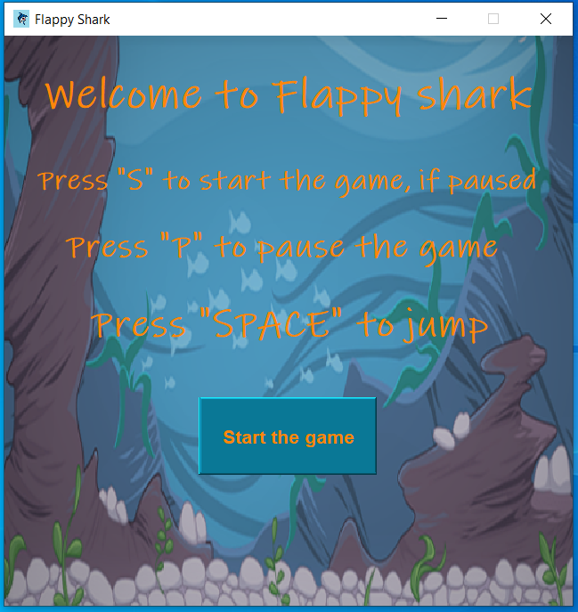
How to play Flappy Shark

Slide 4
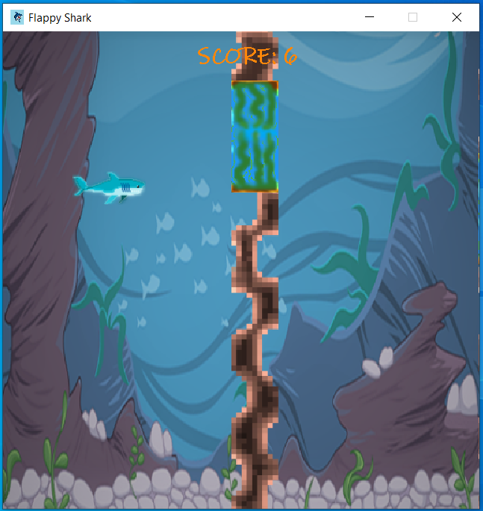

How to play Flappy Shark

Slide 5
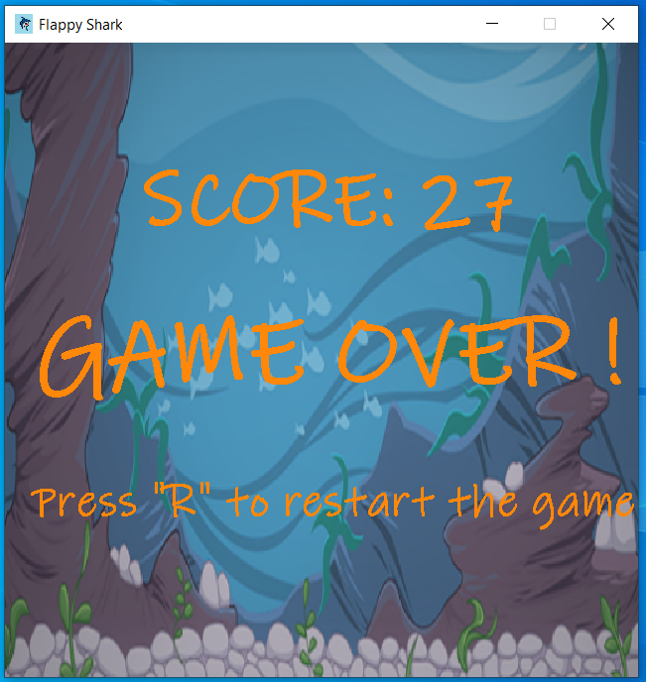
How to play Flappy Shark

Slide 6
Thank you for your time :)

